Slide 1
Introduction to Docker

Slide 2
Introduction
Docker
Basics
Container Lifecycles
Logs
Multi Command Containers
Creating Docker Images
Base Image
Tagging
Real Project with Docker
Multi-Stage Builds
volumes
networking
Docker Compose
project
commands
volumes
networking
crashed containers
Notes:
Prerequisites for the course:
https://github.com/msgsummerpractice/cloud-trainers/tree/main/resources/wsl-docker

Slide 3
Docker - Basics

Slide 4
Why Use Docker?
Flow
Download Installer
This is what Docker is trying to fix
Run Installer
Get Error While Installation
Troubleshoot Issue
Rerun Installer
Get Another Error
Notes:
Bad example:
---
PowerShell
$ cd ~
$ wsl -d alpine $ mkdir redis
$ cd redis
https://redis.io/download
$ wget https://download.redis.io/releases/redis-6.2.1.tar.gz (CONNECT TO PulseSecure to demonstrate first error)
$ tar xzf redis-6.2.1.tar.gz
$ cd redis-6.2.1
$ make (ERROR 2: no make available)
$ src/redis-server
New terminal
$ ./src/redis-cli
→ It will fail when executing make => debug??
---
Good example:
---
docker run -it redis
---

Slide 5
Why Use Docker?
Why use docker?
Docker makes it really easy to install and run software without worrying about setup or dependencies.

Slide 6
What Is Docker?
Docker Ecosystem
Docker Client
Docker Server
Docker is a platform or ecosystem around creating and running containers
Docker Machine
Docker Images
Docker Hub
Docker Compose
Notes:
“I use Docker on my Project”
Might be referring to Client, Server, etc.
All tools to come together to form an ecosystem / platform around creating and running “containers”
Wtf is a container?

Slide 7
What Is Docker?
Container
Image
Container
Single File with all the dependencies and configurations required to run a program
Container
Instance of an image. Runs a program.
Notes:
New terminology:
Docker Image
Docker Container
Explain again what happened when we ran docker run –it redis
docker-cli reached out to docker hub
downloaded an image with all dependencies and configurations to run a very specific program. For example Redis.
Container is an instance of an image (like Class -> Object)
Has own little space of memory, networking, hard drive

Slide 8
What Is Docker?
Docker Desktop
Docker Client (Docker CLI)
Tool to issue commands to
Docker Server (Docker Daemon)
Tool responsible for creating images, running containers, etc.

Slide 9
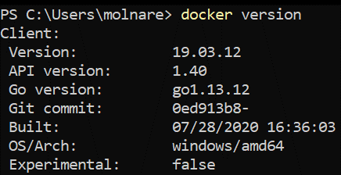
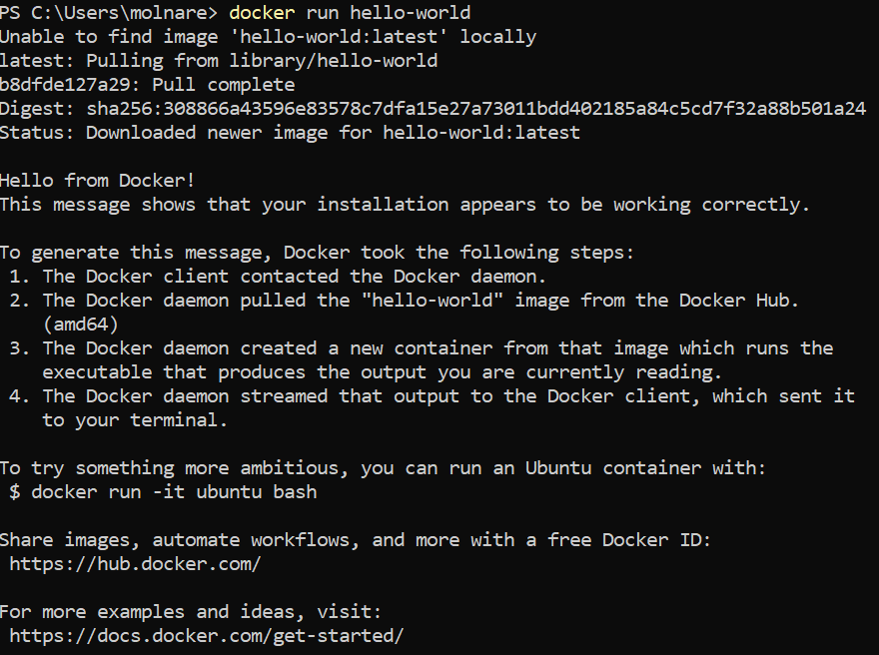
Docker CLI
Notes:
“unable to find image locally”…. What happened?

Slide 10
Docker CLI
Your Computer
Docker Hub
PS C:\Users\molnare> docker run hello-world
Docker Client
hello-world
hello-world
redis
Docker Server
busybox
…
Image Cache
Other Image 1
Other Image 2
Notes:
run hello world again to demonstrate cache

Slide 11
Container Explained
Processes Running on your computer
Chrome
Terminal
Spotify
NodeJS
Running program issues request to kernel to interact with a piece of hardware
System Call
System Call
System Call
Kernel
CPU
Memory
Hard Disk

Slide 12
Container Explained
Needs Java 1.8
Needs Java 21
Java App 1
Java App 2
System Call
System Call
System Call
Kernel
Hard Disk
Java 21
Notes:
How do we solve a problem where a java application needs Java 1.8, another needs java 15 and we can’t have both installed at the same time on our system?

Slide 13
Container Explained
Needs Java 1.8
Needs Java 21
Java App 1
Java App 2
System Call
System Call
System Call
Kernel
Segment for Java App 1
Segment for Java App 2
Hard Disk
Java 1.8
Java 21
Notes:
Namespacing
Java App 1 has access to the segment with Java 1.8, Java App 2 (blabla) Kernel is responsible to figure out which process it is coming from.
Java App 1 -> Java 1.8 segment
Java App 2 -> Java 15 segment

Slide 14
Container Explained
Needs Java 1.8
Needs Java 21
Java App 1
Java App 2
System Call
System Call
System Call
Kernel
Which process is making the system call?
Segment for Java App 1
Segment for Java App 2
Hard Disk
Java 1.8
Java 21
Notes:
Namespacing
Java App 1 has access to the segment with Java 1.8, Java App 2 (blabla) Kernel is responsible to figure out which process it is coming from.
Java App 1 -> Java 1.8 segment
Java App 2 -> Java 15 segment

Slide 15
Container Explained
Processes
Hard drive
Network
Namespacing
Users
Hostnames
Internal Process Communication
Isolating resources per process (or group of processes)
Memory
CPU Usage
HD I/O
Control Groups (cgroups)
Network Bandwidth
Limit amount of resources used per process
Notes:
Control Groups used for limiting the amount of resources used.

Slide 16
Container Explained
Container
Needs Java 1.8
Needs Java 21
Java App 1
Java App 2
System Call
System Call
Kernel
Which process is making the system call?
Segment for Java App 1
Segment for Java App 2
Hard Disk
Java 1.8
Java 15
Notes:
Putting Namespacing and Control Groups together: Container
Container is not physical, it’s logical.

Slide 17
Container Explained
Container
Needs Java 1.8
Java App 1
Kernel
Hard drive
Network
RAM
CPU
Notes:
Putting Namespacing and Control Groups together: Container
Container is not physical, it’s logical.

Slide 18
Container Explained
Container
Running Process
Image
Kernel
Filesystem Snapshot
Startup Command
Filesystem Snapshot
Startup Command
Java App 1
java -jar App1.jar
Java App 1
java -jar App1.jar
RAM
Network
CPU
Hard drive
Notes:
Putting Namespacing and Control Groups together: Container
Container is not physical, it’s logical.

Slide 19
Default Command Override
PS C:\Users\molnare> docker run hello-world
Create and run a container
Override default command
docker
run
<image name>
command
Docker client reference
Image to use for the container

Slide 20
Default Command Override
PS C:\Users\molnare> docker run busybox echo hi there
hi there
PS C:\Users\molnare> docker run busybox echo bye there
bye there
PS C:\Users\molnare> docker run busybox ls bin
dev
etc
home
proc
root
sys
tmp
usr
var
Notes:
Remind of slides in containers explained where the snapshot

Slide 21
Default Command Override
Container
Running Process
Startup Command
docker run busybox will result
in the container to the right
sh
sh
Busybox Image
Kernel
Filesystem Snapshot
Startup Command
bin
dev
etc
sh
home
proc
root
RAM
Network
CPU
Startup Command
…unless we overwrite it’s default command
echo hi there
Filesystem Snapshot
Hard drive segment of the process
bin
dev
etc
home
proc
root
Notes:
Why use busybox and not hello-world image?
Do examples:
docker run hello-world ls
docker run hello-world echo hi there
Command ls and echo executables / programs exist in busybox, but not in hello-world

Slide 22
Container Lifecycle

Slide 23
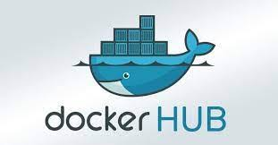
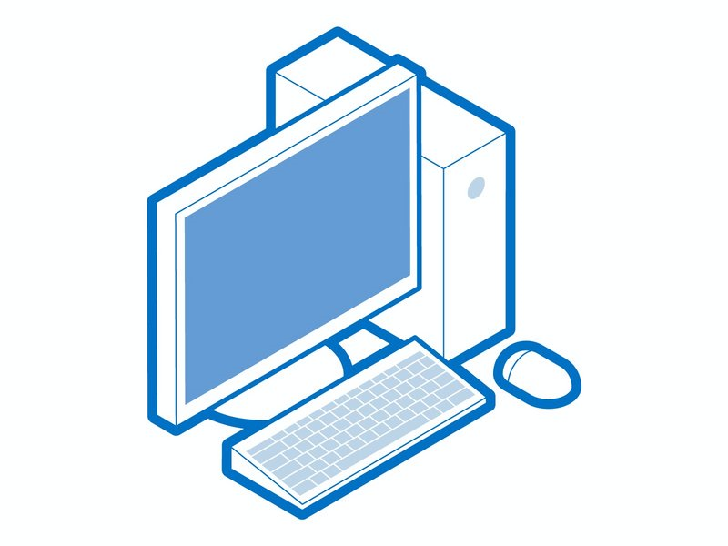
Container Lifecycle
Exited
docker stop demo
docker start demo
docker pull nginx
docker rm demo
docker create --name demo nginx
Created
docker start demo
Started
Dead
docker run -d --name demo nginx
docker unpause demo
docker pause demo
Paused
docker rm demo

Slide 24
Container Lifecycle
List all running containers
docker
ps
Docker client reference

Slide 25
Container Lifecycle
List all containers
docker
ps
-a | --all
Docker client reference
options

Slide 26
Container Lifecycle
PS C:\Users\molnare> docker ps
CONTAINER ID IMAGE COMMAND CREATED STATUS PORTS NAMES
PS C:\Users\molnare> docker run busybox ping www.google.com
PING www.google.com (172.217.20.4): 56 data bytes
64 bytes from 172.217.20.4: seq=0 ttl=37 time=29.656 ms
64 bytes from 172.217.20.4: seq=1 ttl=37 time=29.638 ms
64 bytes from 172.217.20.4: seq=2 ttl=37 time=29.419 ms
64 bytes from 172.217.20.4: seq=3 ttl=37 time=29.733 ms
^C
PS C:\Users\molnare> docker ps
CONTAINER ID IMAGE COMMAND CREATED STATUS PORTS NAMES
36ded3e3ca81 busybox "ping www.google.com" 32 seconds ago Up 31 seconds great_banzai
Notes:
Explain about container id, image, command, crated, status, ports, names
Container id – used for a lot of other operations (later on)
Image – container created with this image
Command – command executed at startup
Created – how long was it created
Status – it’s been up for 31 seconds
Ports – any ports for outside access
Names – randomly generated name (my case great_banzai)
Press Ctrl+C and check if it’s still running by executing docker ps
How do we stop it?
docker stop container-id | name
docker ps again to show that it’s stopped (not in the running containers list)
docker ps –all (show all containers, including stopped containers)

Slide 27
Container Lifecycle
PS C:\Users\molnare> docker run hello-world
Create and run a container
docker
run
<image name>
Docker client reference
Image to use for the container
docker run
=
docker create
+
docker start

Slide 28
Container Lifecycle
Container
Running Process
Creating a container
Starting a container
Busybox Image
Kernel
Filesystem Snapshot
Startup Command
Filesystem Snapshot
Startup Command
bin
dev
etc
ping www.google.com
bin
dev
etc
ping www.google.com
home
proc
root
home
proc
root
RAM
Network
CPU
Hard drive
Hard drive segment of the process
Notes:
Demo:
docker create hello-world
docker start -a <docker id> (-a = --attach, as in watch the output)
Docker start --help and show the -a section Per default no output will be shown, that is why you need -a.

Slide 29
Container Lifecycle
Create and run a container
Override default command
docker
create
<image name>
command
Create a container
Docker client reference
Image to use for the container
Try to start the container
docker
start
<container id(s)>
Start a container
Docker client reference
Container id (see docker ps)
Notes:
Once a container is created it’s default command cannot be overridden.

Slide 30
Container Lifecycle
Try to pause the container
docker
pause
<container id(s) >
Pause a container
Docker client reference
Container id (see docker ps)
Try to stop the container
docker
stop / kill
<container id(s) >
Stop a container
Docker client reference
Container id (see docker ps)
Notes:
Once a container is created it’s default command cannot be overridden.

Slide 31
Container Lifecycle
Container
Running Process
stop
SIGTERM
ping www.google.com
Kernel
Note If the container doesn’t stop under 10 seconds then docker will automatically fall back to issuing the kill command.
RAM
Network
CPU
Filesystem Snapshot
Hard drive segment of the process
bin
dev
etc
home
proc
root
Notes:
SIGTERM ->terminate signal
Received by the process, and means shut down at your own time.
Gives the process time for cleanup.

Slide 32
Container Lifecycle
Container
Running Process
kill
SIGKILL
ping www.google.com
Kernel
RAM
Network
CPU
Filesystem Snapshot
Hard drive segment of the process
bin
dev
etc
home
proc
root
Notes:
SIGKILL ->kill signal
Tells process to shut down immediately without doing any additional work. Demo with docker run busybox ping www.google.com docker stop <container id> docker start <container id> docker kill <container id>

Slide 33
Container Lifecycle
PS C:\Users\molnare> docker create busybox echo hi there
e8af3f2bf5806291bdcb4e0f87db0bad0d867a340043269080cb526fac4b7aa5
PS C:\Users\molnare> docker create busybox ls
1f032e50121c4be24506cbef65551051ca22696a05da299a81069f70afabae27
PS C:\Users\molnare> docker start e8af3f2bf5806291bdcb4e0f87db0bad0d867a340043269080cb526fac4b7aa5
e8af3f2bf5806291bdcb4e0f87db0bad0d867a340043269080cb526fac4b7aa5
PS C:\Users\molnare> docker start -a e8af3f2bf5806291bdcb4e0f87db0bad0d867a340043269080cb526fac4b7aa5
hi there
PS C:\Users\molnare> docker start -a e8af3f2bf5806291bdcb4e0f87db0bad0d867a340043269080cb526fac4b7aa5 ls
you cannot start and attach multiple containers at once
Notes:
Once a container is created it’s default command cannot be overridden.
demo

Slide 34
Container Lifecycle - Housekeeping
Talk to the docker system
Remove unused resources, like stopped containers, unused networks dangling images dangling build cache
docker
system
prune
Docker client reference
Command to execute on docker system
Notes:
Deleting all stopped containers
Demo
docker ps --all docker system prune
docker system prune --all
docker ps --all

Slide 35
Container Lifecycle - Housekeeping
Talk to the docker system
Does almost the same thing as before, but also removes unused images and all build cache
docker
system
prune
--all | -a
Docker client reference
Command to execute on docker system
Notes:
Deleting all stopped containers
Demo
docker ps --all docker system prune
docker system prune --all
docker ps --all

Slide 36
Container Lifecycle - Housekeeping
Talk to the docker system
docker
volume
prune
Remove all unused local volumes
Docker client reference
Command to execute on docker system
Notes:
Deleting all stopped containers
Demo
docker ps --all docker system prune
docker system prune --all
docker ps --all

Slide 37
Container Lifecycle - Housekeeping
Talk to the docker system
Remove all unused volumes, not just anonymous ones
docker
volume
prune
--all | -a
Docker client reference
Command to execute on docker system
Notes:
Deleting all stopped containers
Demo
docker ps --all docker system prune
docker system prune --all
docker ps --all

Slide 38
Logs

Slide 39
Logs
PS C:\Users\molnare> docker create busybox echo hi there
ed4e3ca00f8f516315563d82b02aa5dd43631f0ef835b084dfef145458ad5127
PS C:\Users\molnare> docker start ed4e3ca00f8f516315563d82b02aa5dd43631f0ef835b084dfef145458ad5127
ed4e3ca00f8f516315563d82b02aa5dd43631f0ef835b084dfef145458ad5127
PS C:\Users\molnare> docker ps
CONTAINER ID IMAGE COMMAND CREATED STATUS PORT NAMES
26c9cfc9705d busybox "ping www.google.com" 11 seconds ago Up 4 seconds great_scot
Where did my logs go?
PS C:\Users\molnare> docker logs ed4e3ca00f8f516315563d82b02aa5dd43631f0ef835b084dfef145458ad5127
hi there
Try starting the container multiple times
Notes:
Do Demo with ping www.google.com too.

Slide 40
Multi Command Container

Slide 41
Multi-Command Containers
A container is typically started with one main process.
Sometimes we want to run additional commands inside an already running container. Example: redis-server is running, but we want to run redis-cli too.
PS C:\Users\molnare> docker run redis
41
Notes:
Demo redis wsl:
$ wsl $ ~/redis/redis-6.2.1/src/redis-server
New terminal
$ ~/redis/redis-6.2.1/src/redis-cli $ set mynumber 5
$ get mynumber
$ del mynumber

Slide 42
Multi-Command Containers
Container
Running Process
redis-cli
???
redis-server
Kernel
RAM
Network
CPU
Filesystem Snapshot
Hard drive segment of the process
bin
dev
etc
home
proc
root
42
Notes:
Demo redis wsl:
$ wsl $ ~/redis/redis-6.2.1/src/redis-server
New terminal
$ ~/redis/redis-6.2.1/src/redis-cli $ set mynumber 5
$ get mynumber
$ del mynumber

Slide 43
Multi-Command Containers
This is where docker exec comes into play.
Run another command
The running container’s ID
Remove unused resources, like stopped containers
docker
exec
-it
<container id>
command
Docker client reference
Allows input to the container
Command to execute
Notes:
Deleting all stopped containers
Demo
docker ps --all docker system prune
docker system prune --all
docker ps --all

Slide 44
Multi-Command Containers
Terminal 1:
Terminal 2:
PS C:\Users\molnare> docker run redis
PS C:\Users\molnare> docker exec -it 4c redis-cli
127.0.0.1:6379> SET mynumber 10
OK
127.0.0.1:6379> GET mynumber
"10"
127.0.0.1:6379>
Notes:
Deleting all stopped containers
Demo
docker ps --all docker system prune
docker system prune --all
docker ps --all

Slide 45
Multi-Command Containers
ping www.google.com
redis-cli
STDIN
STDOUT
STDERR
STDIN
STDOUT
STDERR
Terminal
Stuff you type
Stuff that shows up on the screen
Notes:
Why need the -it flag? -i redirects everything we write on the terminal to the container (keeps STDIN open)
-t makes sure that all text entered, returned shows up nicely formatted (allocates a terminal. does more in the background, but this is it’s effect)
Can be written separately: -i -t
demo with -i
docker exec -i <container od> redis-cli (no autocomplete, no format, nothing)
demo with full terminal access for debugging: docker exec -it <container od> sh ls
Pwd
Whoami
echo hi there
If you can’t exit a container then Ctrl+D

Slide 46
Multi-Command Containers
bash
powershell
zsh
sh
Command Processors
Notes:
These are all command processors

Slide 47
Multi-Command Containers
Create and run a container
Image to use for the container
Create and start container with sh instead of default command.
docker
run
-it
<image name>
sh
Docker client reference
Allows input to the container
Command to execute
Notes:
Run two of these in two separate terminals and demonstrate that they have nothing in common with each other:
Create a file in one and list it in the other, where it won’t exist.

Slide 48
Creating Docker Images

Slide 49
Creating Docker Images
Dockerfile
Docker Client
Docker Server
Usable Image
Configuration of behavior the resulting image

Slide 50
Creating Docker Images
Flow
Dockerfile
Specify a base image
Run some commands to do some configuration, install additional programs, etc.
Specify the default command to run on container startup.
Notes:
What is the basest base image you might ask? https://docs.docker.com/develop/develop-images/baseimages/#create-a-simple-parent-image-using-scratch

Slide 51
Creating Docker Images
Dockerfile
GOAL: Create an image that runs redis-server from scratch!
Notes:
Do a live demo by creating the docker image with redis

Slide 52
Creating Docker Images
Docker server instructions
Arguments to the Docker server instructions
FROM
alpine
RUN
apk add --update redis
CMD
[“redis-server”]
Notes:
If msg Zscaler causes issues then: FROM alpine:latest COPY ./resources/wsl-docker/certificates/ /usr/local/share/ca-certificates/ RUN apk add --no-cache --no-check-certificate ca-certificates RUN update-ca-certificates RUN apk add redis CMD ["redis-server"]

Slide 53
Creating Docker Images
FROM
alpine
RUN
[“redis-server”]
Download alpine image
Get the image from previous step
Create a container out of it
RUN
apk add --update redis
Tell container to run redis-server when started
Get the image from previous step
Shut down container
temporary container
Create a container from the image
Get Image ready for next instructions
yet another container with modified filesystem
Run “apk add –update redis” in it
Take a snapshot of the filesystem
filesystem snapshot
Shut down the temporary container
Get image ready for next instructions
Notes:
Demo:
docker create hello-world
docker start -a <docker id> (-a = --attach, as in watch the output)
Docker start --help and show the -a section Per default no output will be shown, that is why you need -a.

Slide 54
Creating Docker Images
Temporary Container
Creating a temporary container
Creating final Image
Running Process
Alpine Image
91072d98cfee09f7e9… Image
826f70e0ac33e99a72… Image
Filesystem Snapshot
Startup Command
Filesystem Snapshot
CMD
Startup Command
bin
dev
etc
Kernel
apk add –update redis
bin
dev
etc
redis-server
apk add –update redis
home
proc
root
redis-server
home
proc
root
RAM
Network
CPU
Hard drive
Hard drive segment of the process
Notes:
Demo:
docker create hello-world
docker start -a <docker id> (-a = --attach, as in watch the output)
Docker start --help and show the -a section Per default no output will be shown, that is why you need -a.

Slide 55
Base Image

Slide 56
What’s a base image?
Writing a Dockerfile
being given a computer without an OS and being told to install Chrome on it
==
Notes:
Thought exercise:
Writing a Dockerfile is a little bit like being given a computer without an OS and being told to install Chrome on it.

Slide 57
What’s a base image?
How do you install Chrome on a computer with no operating system?
Flow
Install an OS
specify a base image
Start up the default browser
Navigate to google.com/chrome
run commands to install additional commands
Download installer
Execute Installer.exe
Execute chrome.exe
command to run on startup
Notes:
Thought exercise:
Install an OS because without it you’d just get some boot information
Why alpine and not something else? (Why do you use Windows and not Mac or Ubuntu, or something else?)
-> it suits your needs. It has preinstalled programs that suit your needs and goals. (apk)

Slide 58
Build Process

Slide 59
Tagging Docker Images

Slide 60
Tagging Docker Images
The tag itself
docker
build
-t
melod/redis:latest
.
Tag the image
Build Directory
my docker id
melod
/
redis
:
latest
repo / project name
version
Notes:
Run two of these in two separate terminals and demonstrate that they have nothing in common with each other:
Create a file in one and list it in the other, where it won’t exist.

Slide 61
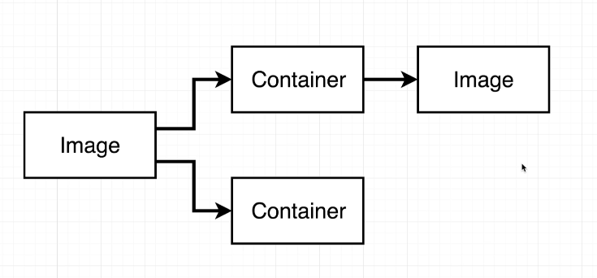
Docker Image Generation
terminal 1
PS C:\Users\molnare> docker run -it alpine sh
/ # apk add --update redis
(…)
/ #
terminal 2
PS C:\Users\molnare> docker ps
CONTAINER ID IMAGE COMMAND CREATED STATUS PORTS NAMES
1f90b78d47e8 alpine "sh" 33 seconds ago Up 33 seconds clever_galileo
PS C:\Users\molnare> docker commit -c “CMD redis-server” 1f90b78d47e8
Notes:
Run two of these in two separate terminals and demonstrate that they have nothing in common with each other:
Create a file in one and list it in the other, where it won’t exist.

Slide 62
Real Project with Docker

Slide 63
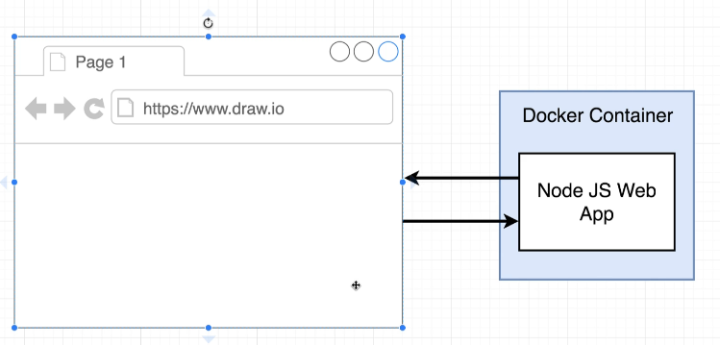
Real Project with Docker
Notes:
Run two of these in two separate terminals and demonstrate that they have nothing in common with each other:
Create a file in one and list it in the other, where it won’t exist.

Slide 64
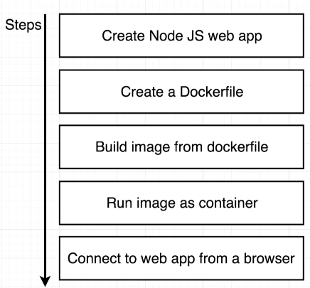
Real Project with Docker
Notes:
Run two of these in two separate terminals and demonstrate that they have nothing in common with each other:
Create a file in one and list it in the other, where it won’t exist.

Slide 65
Real Project with Docker
index.js
package.json
const express = require('express'); const app = express(); app.get('/', (req, res) => { res.send('Hi there'); }); app.listen(8080, () => { console.log('Listening on port 8080'); });
{ "dependencies": { "express": "*" }, "scripts": { "start": "node index.js" } }
Notes:
Run two of these in two separate terminals and demonstrate that they have nothing in common with each other:
Create a file in one and list it in the other, where it won’t exist.

Slide 66
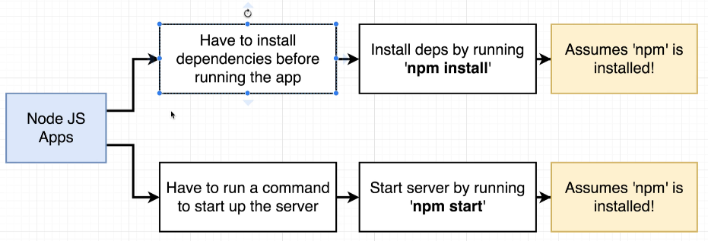
Real Project with Docker
Notes:
Run two of these in two separate terminals and demonstrate that they have nothing in common with each other:
Create a file in one and list it in the other, where it won’t exist.

Slide 67
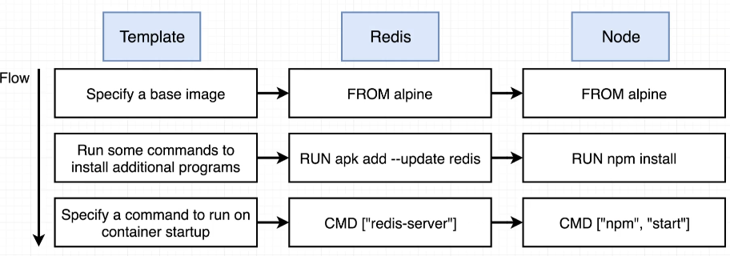
Real Project with Docker
Notes:
Run two of these in two separate terminals and demonstrate that they have nothing in common with each other:
Create a file in one and list it in the other, where it won’t exist.

Slide 68
Real Project with Docker
good enough example
Bad Example
FROM node:lts-alpine3.20 WORKDIR /usr/app COPY ./source/package.json /usr/app RUN npm install COPY ./source/index.js /usr/app/ CMD ["npm", "start"]
FROM alpine RUN npm install CMD ["npm", "start"]
Almost good example
node, npm is not installed
files are not in the image
FROM node:lts-alpine3.20 WORKDIR /usr/app COPY ./source/index.js /usr/app/ COPY ./source/package.json /usr/app/ RUN npm install CMD ["npm", "start"]
Optimization: changing inde.js doesn’t cause npm install to execute again
Almost good example
FROM alpine RUN apk add --update nodejs npm WORKDIR /usr/app COPY ./source/index.js /usr/app/ COPY ./source/package.json /usr/app/ RUN npm install CMD ["npm", "start"]
search for alpine based node image on docker hub resulting image is bigger, but node image takes away
node runtime installation concern
install nodejs and npm yourself
Notes:
Run two of these in two separate terminals and demonstrate that they have nothing in common with each other:
Create a file in one and list it in the other, where it won’t exist.

Slide 69
Multi-Stage Builds

Slide 70
Multi-Stage Builds
Template
# Stage 1: Build Environment FROM builder-image AS build-stage # Install build tools (e.g., Maven, Gradle) # Copy source code # Build commands (e.g., compile, package) # Stage 2: Runtime environment FROM runtime-image AS final-stage # Copy application artifacts from the build stage (e.g., JAR file) COPY --from=build-stage /path/in/build/stage /path/to/place/in/final/stage # Define runtime configuration (e.g., CMD, ENTRYPOINT)
Notes:
Run two of these in two separate terminals and demonstrate that they have nothing in common with each other:
Create a file in one and list it in the other, where it won’t exist.

Slide 71
Multi-Stage Builds
Example
# Stage 1 - Build FROM node:lts-alpine3.20 AS build-stage WORKDIR /app # Copy package.json and install dependencies COPY ./source/package.json . RUN npm install # Copy the rest of the source code COPY ./source/index.js .
# Stage 2 - Runtime FROM node:lts-alpine3.20 AS final-stage WORKDIR /app # Copy only the necessary files from the build stage COPY --from=build-stage /app/node_modules ./node_modules COPY --from=build-stage /app/index.js . COPY --from=build-stage /app/package.json . # Expose the application port EXPOSE 8080 # Start the application CMD ["npm", "start"]
Notes:
Run two of these in two separate terminals and demonstrate that they have nothing in common with each other:
Create a file in one and list it in the other, where it won’t exist.

Slide 72
Multi-Stage Builds
Build a Specific Stage
Multi-stage Dockerfiles can contain several build stages.
You do not have to build all stages every time.
Use the --target option to stop the build at a specific stage.
Useful for:
Testing intermediate stages
Debugging build issues
Speeding up development workflows
PS C:\Users\molnare> docker build --target build-stage -t hello .
Notes:
Run two of these in two separate terminals and demonstrate that they have nothing in common with each other:
Create a file in one and list it in the other, where it won’t exist.

Slide 73
Multi-Stage Builds
Use multiple FROM instructions in a single Dockerfile.
Each FROM starts a new build stage and can use a different base image.
Build dependencies and tools remain in intermediate stages.
Use COPY --from=<stage> to transfer only the required artifacts to the next stage.
The final image contains only what is needed, resulting in:
Smaller image size
Improved security
Faster deployment and startup times
Key Benefit: Separate the build environment from the runtime environment, keeping production images clean and lightweight.
Notes:
Run two of these in two separate terminals and demonstrate that they have nothing in common with each other:
Create a file in one and list it in the other, where it won’t exist.

Slide 74
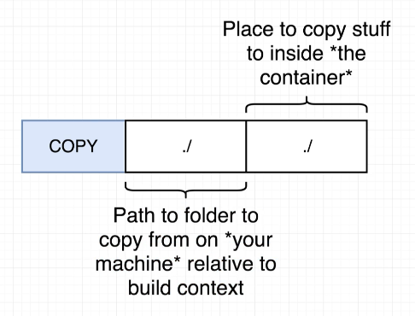
Real Project with Docker
Notes:
Run two of these in two separate terminals and demonstrate that they have nothing in common with each other:
Create a file in one and list it in the other, where it won’t exist.

Slide 75
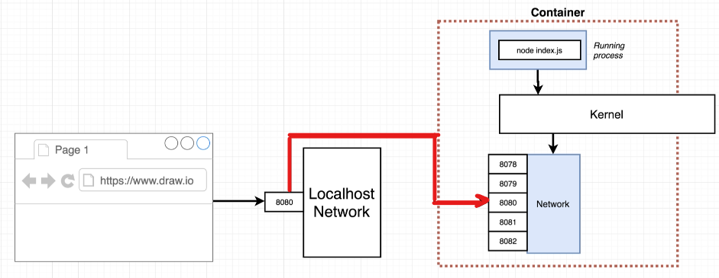
Real Project with Docker
Notes:
Run two of these in two separate terminals and demonstrate that they have nothing in common with each other:
Create a file in one and list it in the other, where it won’t exist.

Slide 76
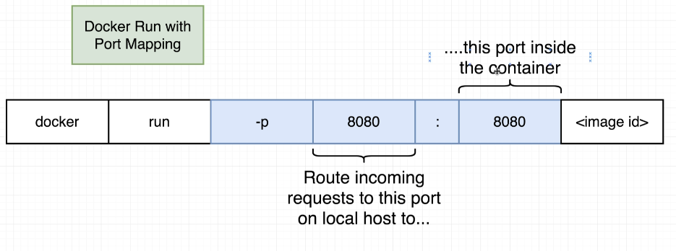
Real Project with Docker
Notes:
Run two of these in two separate terminals and demonstrate that they have nothing in common with each other:
Create a file in one and list it in the other, where it won’t exist.

Slide 77
Docker - Volumes

Slide 78
Docker - Volumes
Volumes provide persistent storage for containers.
Managed by Docker and stored on the Docker host.
Create volumes manually: And then use in docker container:
Or let Docker create them automatically when a container starts.
Volumes can be mounted into one or more containers.
Data remains available even if the container is removed.
Why Use Volumes?
persistence
Share data between containers
Separate data from application code
Key Benefit: Containers are temporary, but data stored in volumes remains persistent and reusable.
PS C:\Users\molnare> docker volume create my-volume
PS C:\Users\molnare> docker run -it --volume my-volume alpine sh / # touch /mnt/test.txt
Notes:
Run two of these in two separate terminals and demonstrate that they have nothing in common with each other:
Create a file in one and list it in the other, where it won’t exist.

Slide 79
Docker - Networking

Slide 80
Docker - Volumes
Docker networking enables containers to communicate with each other, the host machine, and external services through Docker-managed networks.
PS C:\Users\molnare> docker network create my-awesome-network
PS C:\Users\molnare> docker run -it --rm --name foo --network test alpine sh
PS C:\Users\molnare> docker run -it --rm --name bar --network test alpine sh / # ping foo
PING foo (172.18.0.2): 56 data bytes
64 bytes from 172.18.0.2: seq=0 ttl=64 time=0.217 ms
64 bytes from 172.18.0.2: seq=1 ttl=64 time=0.086 ms
Notes:
Run two of these in two separate terminals and demonstrate that they have nothing in common with each other:
Create a file in one and list it in the other, where it won’t exist.

Slide 81
Docker Compose - Project

Slide 82
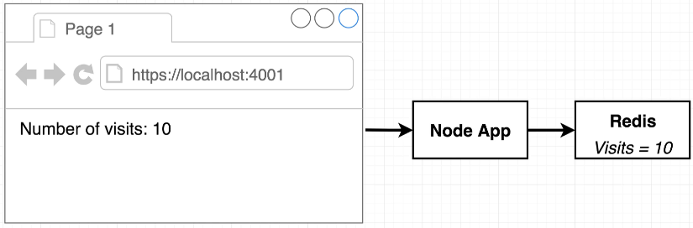
Docker Compose - Project

Slide 83
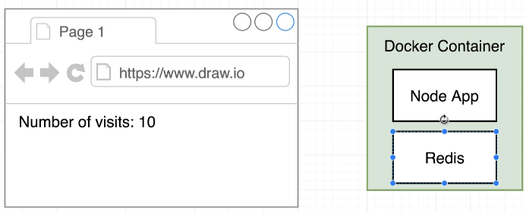
Docker Compose - Project
Why not to use single container for both Node and Redis?

Slide 84
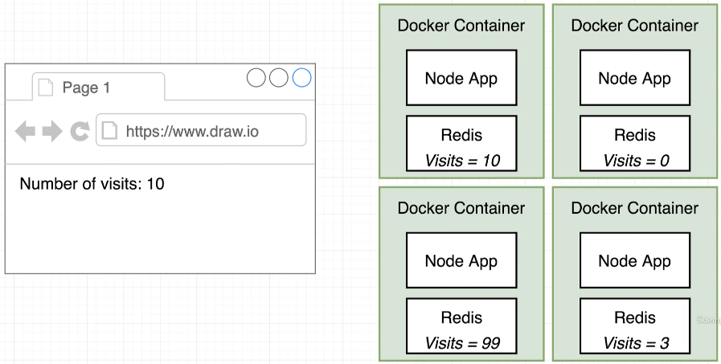
Docker Compose - Project
Single container won’t work in real world because:
as requests grow multiple container instances are needed
containers would be isolated from each other

Slide 85
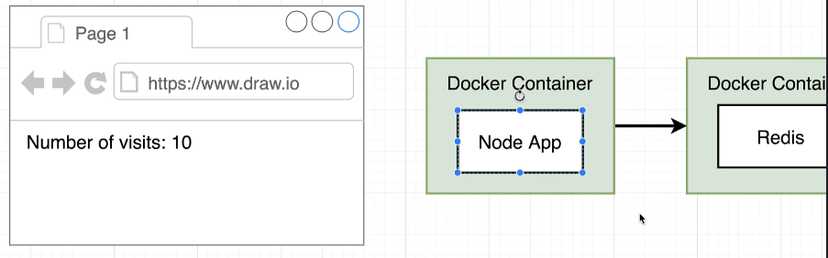
Docker Compose - Project
Solution:
docker container for node app
docker container for Redis server

Slide 86
Docker Compose - Project
index.js
const express = require('express'); const redis = require('redis'); const os = require('os'); const app = express(); const client = redis.createClient({ host: 'redis-server', port: 6379 }); client.set('visits', 0); app.get('/', (req, res) => { // when we try to access it in the browser // this will cause the process to exit and stop the pod // process.exit(0); client.get('visits', (err, visits) => { res.send( 'Number of visits is ' + visits + '<br>Hostname: ' + os.hostname() ); client.set('visits', parseInt(visits) + 1); }); }); app.listen(8081, () => { console.log('Listening on port 8081'); });
package.json
{ "dependencies": { "express": "*", "redis": "2.8.0" }, "scripts": { "start": "node index.js" } }

Slide 87
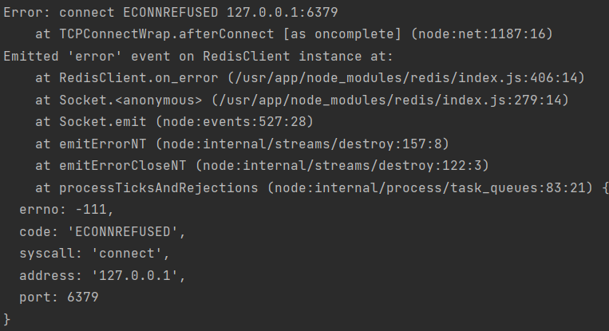
Docker Compose - Project
create node app
create Redis container
error…

Slide 88
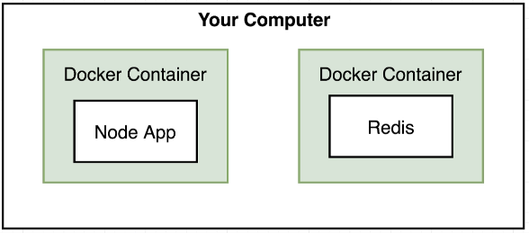
Docker Compose - Project
By default, docker containers can’t talk to each other

Slide 89
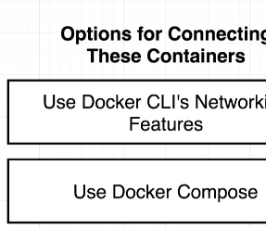
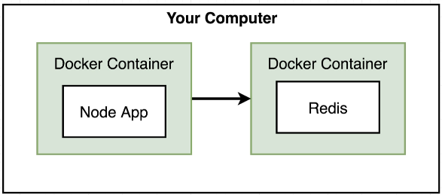
Docker Compose - Project

Slide 90
Docker Compose - Project
PS C:\Users\molnare> docker network create app-network
cdd7850ea26ba2125e2df5fa205415d39b5173752193d2893e0bf7af86374f6f
PS C:\Users\molnare> docker run --rm -d --network app-network --name redis-server redis
fd56093d00ed8f9ab1687d097a81bebb9a82d025c2ae6fd21bd0f548968406ff
PS C:\Users\molnare> docker run --network app-network -p 8080:8081 app
> start
> node index.js
Listening on port 8081
And afterwards, when you are done, good luck cleaning up.
There has to be a better way!

Slide 91
Docker Compose - Project
Docker Compose is a tool for defining and running multi-container applications.
Application components are described in a single YAML configuration file.
Manage services, networks, and volumes from one central location.
Launch the entire application stack with a single command.
Automate some of the long-winded arguments passed to docker run.
Works consistently across:
Development
Testing
Staging
Production
CI/CD pipelines

Slide 92
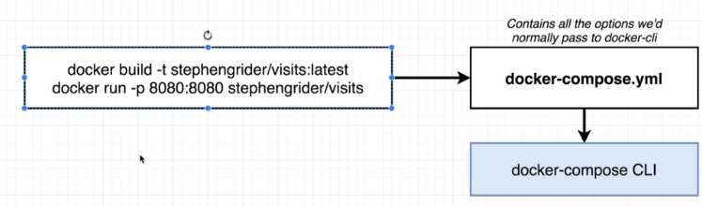
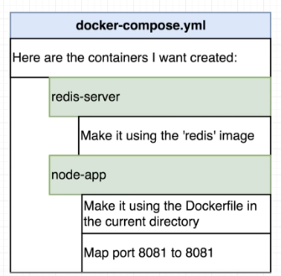
Docker Compose - Project

Slide 93
Docker Compose - Project
docker-compose.yml
services: redis-server: image: 'redis' node-app: build: . ports: - '8081'
PS C:\Users\molnare> docker compose up
# or
PS C:\Users\molnare> docker compose up --scale node-app=3

Slide 94
Docker Compose - Commands

Slide 95
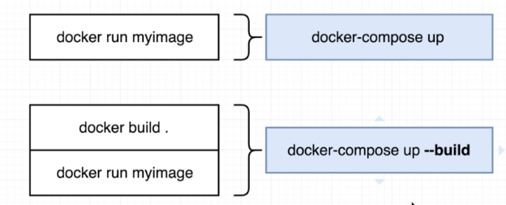
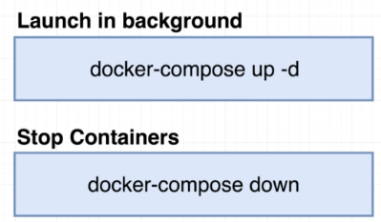
Docker Compose Commands

Slide 96
Docker Compose - Crashed Containers

Slide 97

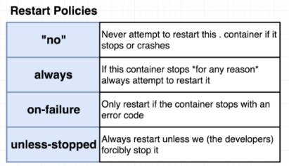
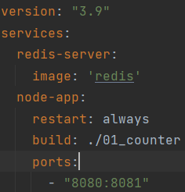
Docker Compose – Crashed Pods
Rebuild, relaunch. When you try to access the app in the browser, the pod will stop.
we can define restart policies:
Try it with on-failure policy too and exit code 0, see what happens.
check running pods with: docker compose ps
no has to be quoted due toyaml syntax

